Slide 1
SENTIMENT ANALYSIS IN MARKETING Phase 4(Development part 2)

Slide 2
SHALINI SIVAKUMAR S
B.E(CSE) 3RD YEAR
EMAIL ID: sshalini5404@gmail.com
NM ID: au513521104045

Slide 3
INTRODUCTION
Visualising and counting sentiments of tweets for each airline.
Wordcloud plots for negative tweets to visualise most frequent words for each.
Wordcloud plots for positive tweets to visualise most frequent words for each.
Analysing the reasons for negative tweets for each airline.
Visualising negative tweet-sentiment relationship with dates.
A relationship between negative sentiments and date

Slide 4
Visualising and counting sentiments of tweets for each airline.
print("Total number of tweets for each airline \n ",df.groupby('airline')['airline_sentiment'].count().sort_values(ascending=False))
airlines= ['US Airways','United','American','Southwest','Delta','Virgin America']
plt.figure(1,figsize=(12,12))
for i in airlines:
indices= airlines.index(i)
plt.subplot(2,3,indices+1)
new_df=df[df['airline']==i]
count=new_df['airline_sentiment'].value_counts()
Index = [1,2,3]
plt.bar(Index,count, color=['blue', 'green', 'red'])
plt.xticks(Index,['negative','neutral','positive'])
plt.ylabel('Mood Count')
plt.xlabel('Mood')
plt.title('Count of Moods of '+i)
plt.show()

Slide 5
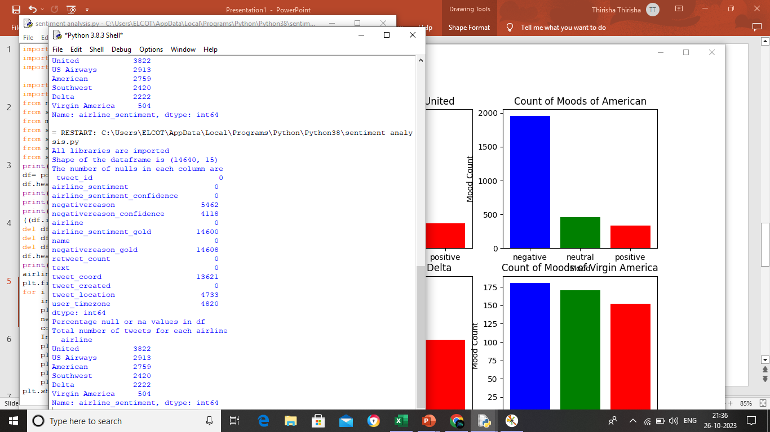
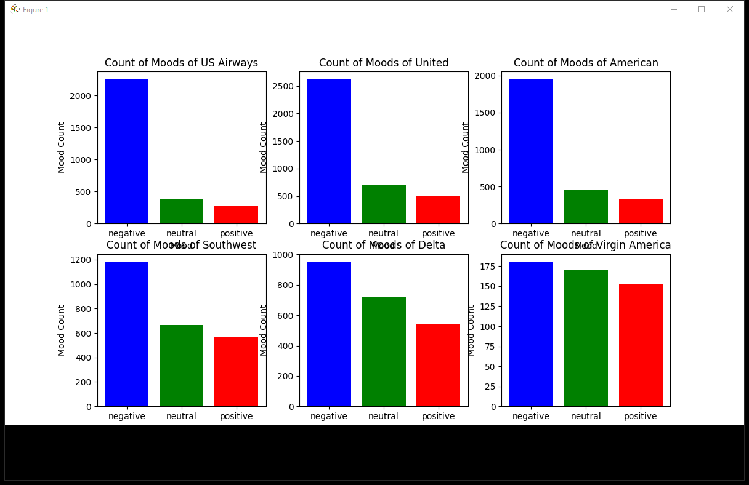
OUTPUT:

Slide 6
Wordcloud plots for negative tweets to visualise most frequent words for each.
from wordcloud import WordCloud,STOPWORDS
new_df=df[df['airline_sentiment']=='negative']
words = ' '.join(new_df['text'])
cleaned_word = " ".join([word for word in words.split()
if 'http' not in word
and not word.startswith('@')
and word != 'RT'
])
wordcloud = WordCloud(stopwords=STOPWORDS,
background_color='white',
width=3000,
height=2500
).generate(cleaned_word)
plt.figure(1,figsize=(15, 15))
plt.imshow(wordcloud)
plt.axis('off')
plt.show()

Slide 7
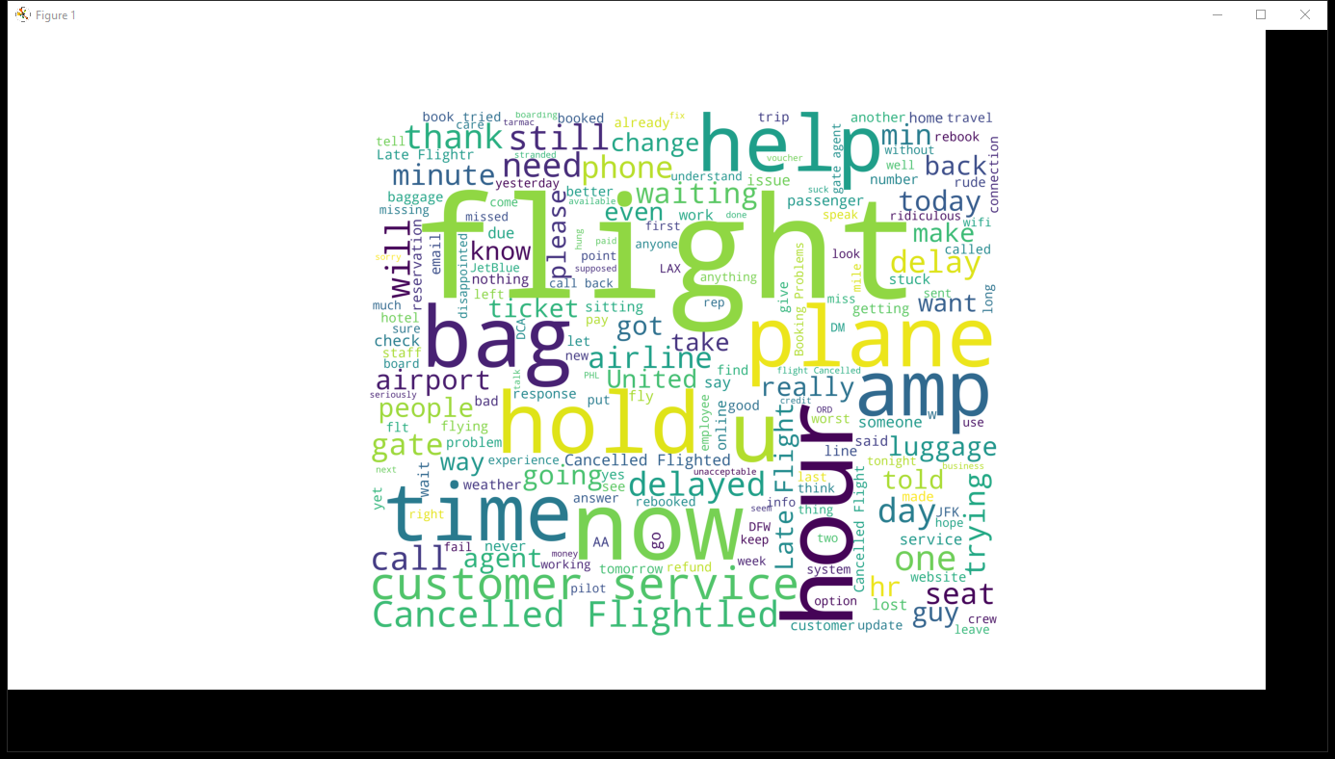
OUTPUT:

Slide 8
Wordcloud plots for positive tweets to visualise most frequent words for each
new_df=df[df['airline_sentiment']=='positive']
words = ' '.join(new_df['text'])
cleaned_word = " ".join([word for word in words.split()
if 'http' not in word
and not word.startswith('@')
and word != 'RT'
])
wordcloud = WordCloud(stopwords=STOPWORDS,
background_color='white',
width=3000,
height=2500
).generate(cleaned_word)
plt.figure(1,figsize=(15,15))
plt.imshow(wordcloud)
plt.axis('off')
plt.show()

Slide 9
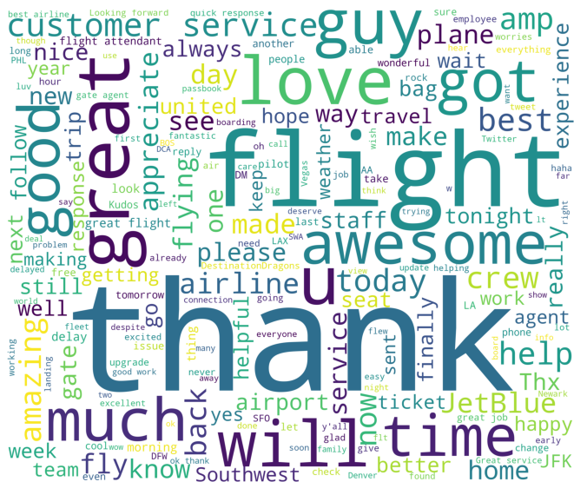
OUTPUT:

Slide 10
Visualising negative tweet-sentiment relationship with dates
airlines= ['US Airways','United','American','Southwest','Delta','Virgin America']
df['negativereason'].nunique()
NR_Count=dict(df['negativereason'].value_counts(sort=False))
def NR_Count(Airline):
if Airline=='All':
a=df
else:
a=df[df['airline']==Airline]
count=dict(a['negativereason'].value_counts())
Unique_reason=list(df['negativereason'].unique())
Unique_reason=[x for x in Unique_reason if str(x) != 'nan']
Reason_frame=pd.DataFrame({'Reasons':Unique_reason})
Reason_frame['count']=Reason_frame['Reasons'].apply(lambda x: count[x])
return Reason_frame
def plot_reason(Airline):
a=NR_Count(Airline)
count=a['count']
Index = range(1,(len(a)+1))

Slide 11
plt.bar(Index,count, color=['blue','yellow','red','orange','black','brown','gray','cyan','purple','green'])
plt.xticks(Index,a['Reasons'],rotation=90)
plt.ylabel('Count')
plt.xlabel('Reason')
plt.title('Count of Reasons for '+Airline)
plot_reason('All')
plt.figure(2,figsize=(15,15))
for i in airlines:
indices= airlines.index(i)
plt.subplot(2,3,indices+1)
plt.subplots_adjust(hspace=0.9)
plot_reason(i)
plt.show()

Slide 12
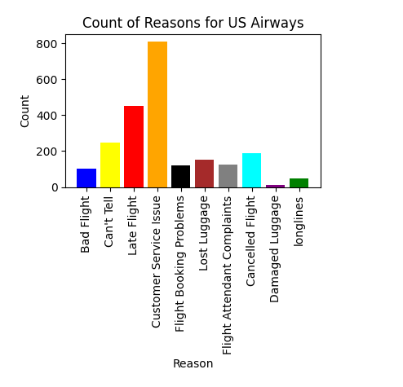
OUTPUT:

Slide 13
A RELATIONSHIP BETWEEN NEGATIVE SENTIMENTS AND DATE
day_df = day_df.loc(axis=0)[:,:,'negative']
#groupby and plot data
ax2 = day_df.groupby(['tweet_created','airline']).sum().unstack().plot(kind = 'bar', color=['blue', 'green', 'red','yellow','orange','purple'], figsize = (15,8), rot = 70)
labels = ['American','Delta','Southwest','US Airways','United','Virgin America']
ax2.legend(labels = labels)
ax2.set_xlabel('Date')
ax2.set_ylabel('Negative Tweets')
plt.show()

Slide 14
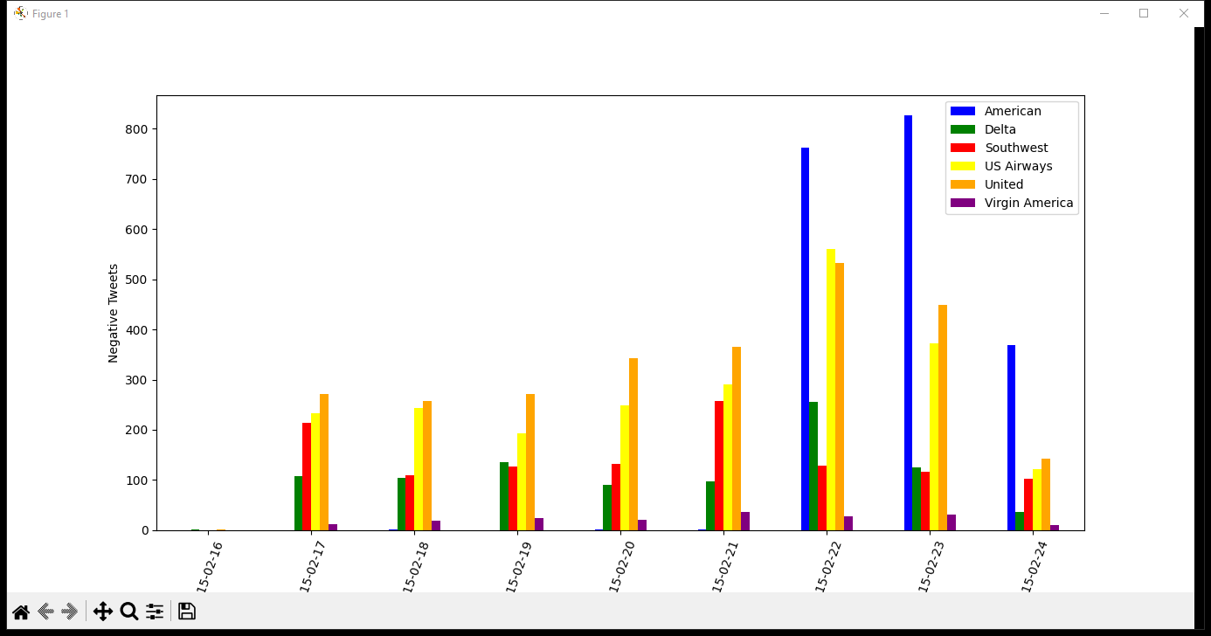
OUTPUT:

